Slide 1
DATA SCIENCE MINIPROJECT
Team members
M. Sankara Narayanan
s. Harisiva balan
v. Muthu krishnan

Slide 2
OBJECTIVE OF THE PROJECT
TOPIC – VEHICLE COUNT PREDICTION
Loading Data: It reads a CSV file named 'traffic.csv' containing traffic-related data.
Data Preprocessing: It converts the 'DateTime' column to datetime format, sorts the data by 'DateTime', and reshapes the 'Junction' column for model fitting.
Linear Regression Modeling: It uses Linear Regression from scikit-learn to create a predictive model for vehicle counts based on the 'Junction' column.
Visualization: It generates various types of visualizations:
Scatter plot of vehicle counts against date and time, with a regression line indicating the predicted values.
Bar graph showing vehicle count over time.
Histogram displaying the frequency distribution of vehicle counts.
Scatter plot comparing vehicle counts with the 'Junction'.
Pie chart representing the proportion of vehicle counts over time.
Descriptive Statistics: It calculates and displays mean, median, mode, and standard deviation of vehicle counts.
The code overall demonstrates a basic workflow for analyzing vehicle count data, performing regression analysis, and visualizing the results. It could be part of a larger project aimed at understanding traffic patterns, predicting future vehicle counts, or aiding in decision-making related to traffic management and infrastructure planning based on historical data

Slide 3
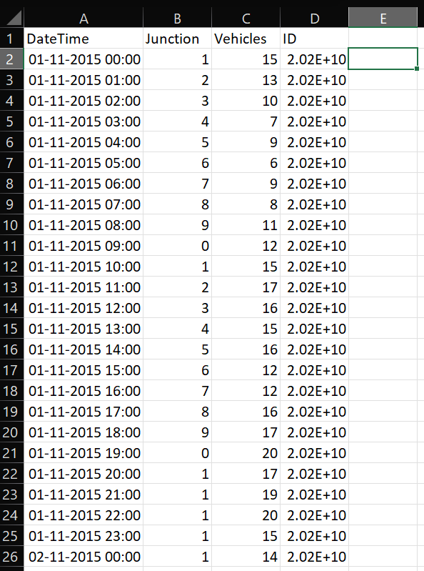
DATASETS WITH FEATURES SELECTION

Slide 4
DATA PREPROCESSING AND CLEANING
Data Loading: The code begins by loading data from a CSV file into a Pandas DataFrame using pd.read_csv('/content/traffic.csv').
Data Conversion: The 'DateTime' column is converted to datetime format using pd.to_datetime(data['DateTime']).
Sorting Data: The data is sorted by the 'DateTime' column using data.sort_values('DateTime').
Modeling: It uses linear regression from sklearn.linear_model to create a model to predict vehicle counts based on the 'Junction' column.
Visualization: Several visualizations are created using Matplotlib:
A scatter plot of vehicle counts against date and time (plt.scatter).
A line plot showing the predicted values from the regression model (plt.plot).
A bar graph illustrating vehicle counts over time (plt.bar).
A histogram displaying the frequency distribution of vehicle counts (plt.hist).
Scatter plot comparing vehicle counts with the 'Junction' (plt.scatter).

Slide 5
6. Descriptive Statistics:
data['Vehicles'].mean(): Calculates the mean of the 'Vehicles' column.
data['Vehicles'].median(): Calculates the median of the 'Vehicles' column.
data['Vehicles'].mode(): Determines the mode (most frequently occurring value) of the 'Vehicles' column.
data['Vehicles'].std(): Computes the standard deviation of the 'Vehicles' column.
These are basic descriptive statistical measures used to understand the central tendency and dispersion of the 'Vehicles' data
7. Visualization (Pie Chart):
data.groupby('DateTime')['Vehicles'].sum().head(): Groups the data by 'DateTime' and calculates the sum of 'Vehicles' for each group, taking the top few entries.
plt.pie(): Creates a pie chart showing the proportions of vehicle counts over time.

Slide 6
DATA MODELING
Modeling with Linear Regression
Feature-Target Preparation:
Reshaping the 'Junction' column as the feature ('X') and 'Vehicles' as the target ('y') for linear regression modeling.
Model Fitting:
Utilizing the LinearRegression model from Scikit-Learn to fit the data and predict vehicle counts based on junction information

Slide 7
CODE LINK
https://colab.research.google.com/drive/1ju_1m2IxWouT1kHrCUur0uPgK_2KsYiG?usp=sharing

Slide 8
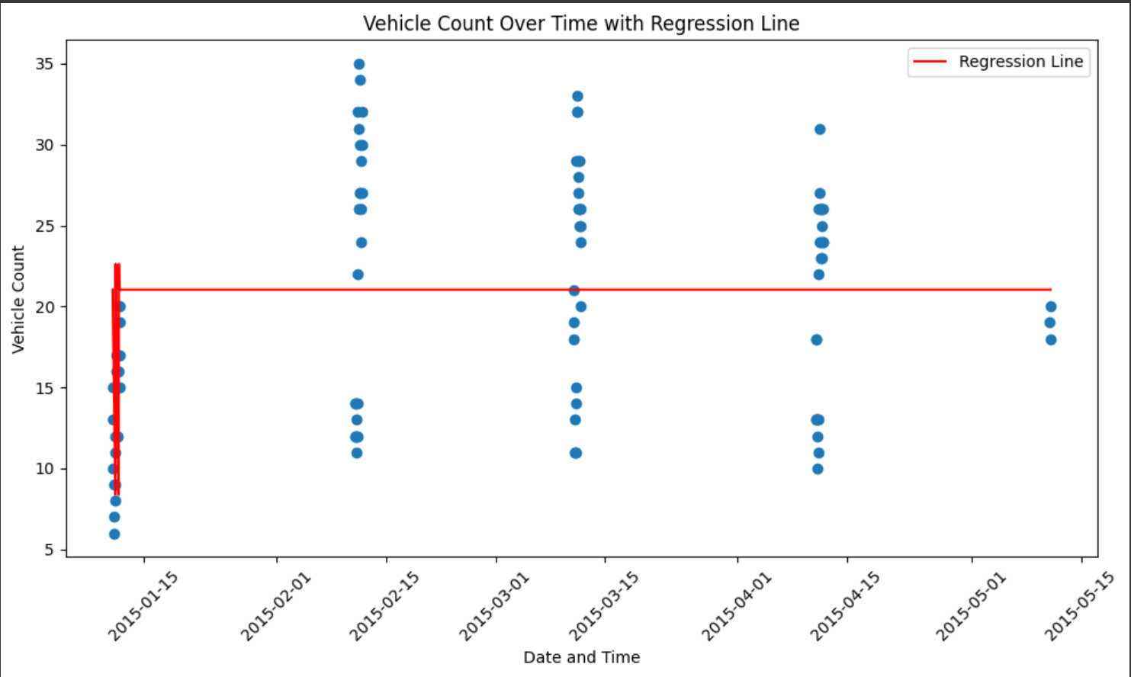
RESULT
SCATTER PLOT FOR LINEAR REGRESSION BETWEEN DATETIME AND VEHICLE COUNT

Slide 9
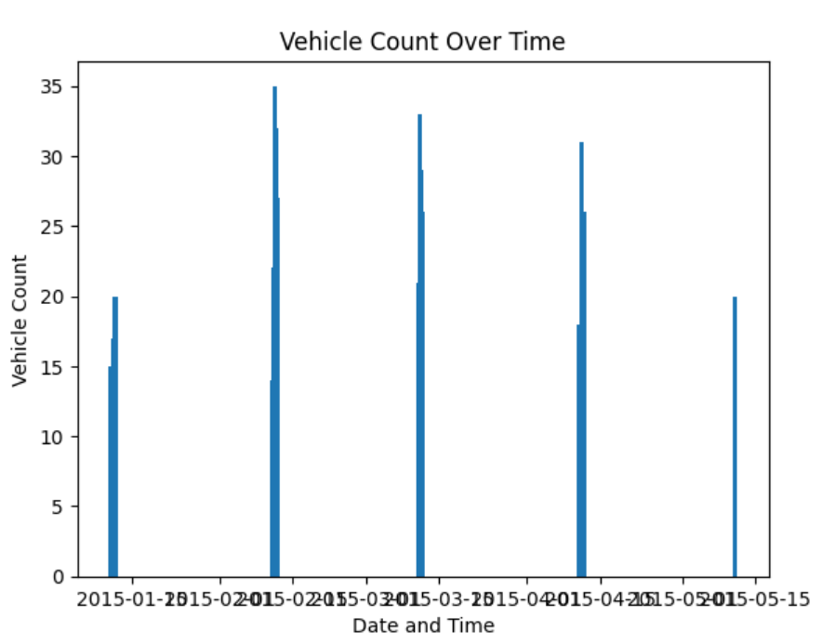
BAR GRAPH BETWEEN THE DATETIME AND VEHICLE COUNT

Slide 10
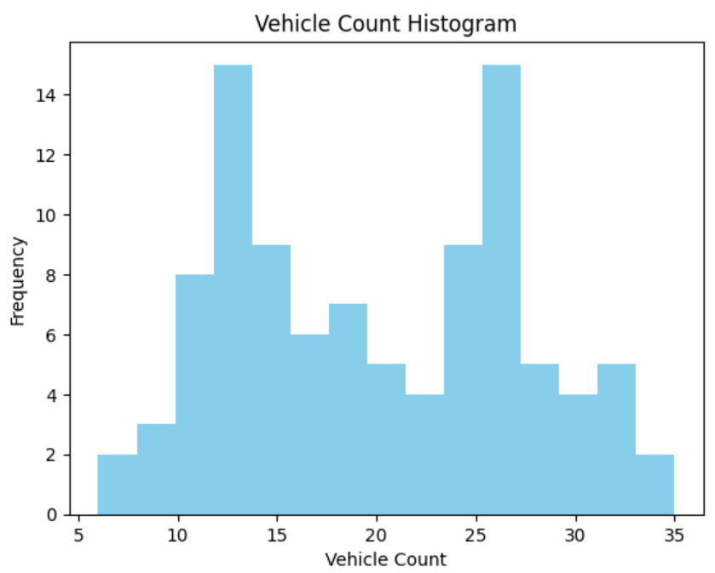
HISTOGRAM BETWEEN THE JUNCTION AND VEHICLE COUNT

Slide 11
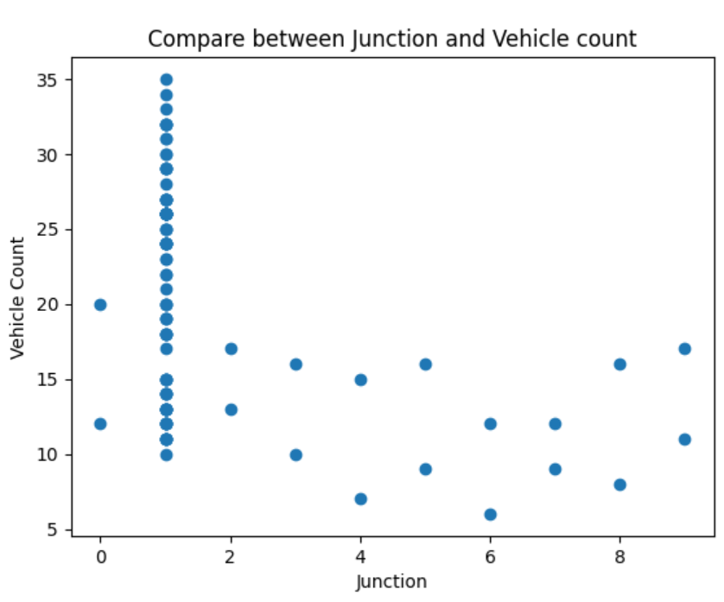
SCATTER PLOT BETWEEN THE JUNCTION AND VEHICLE COUNT

Slide 12
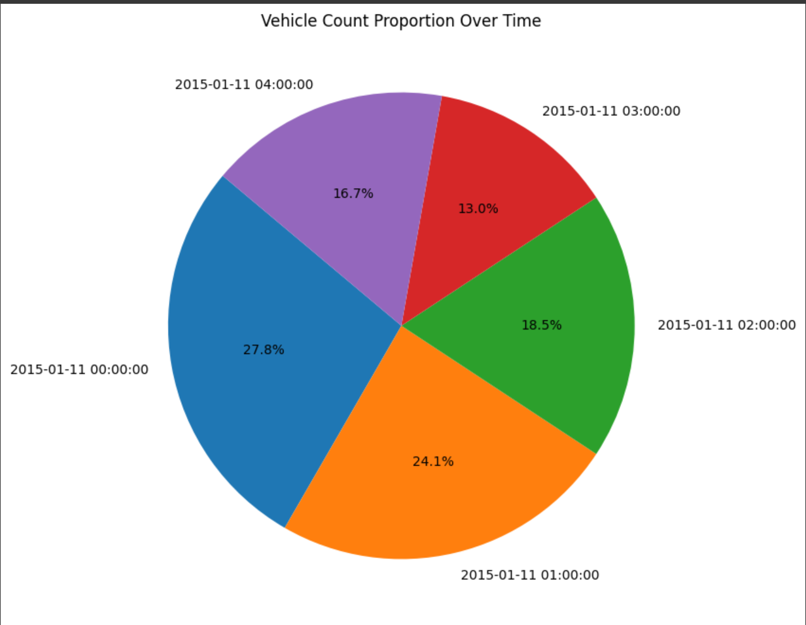
PIE CHART BETWEEN THE DATETIME AND VEHICLE COUNT

Slide 13
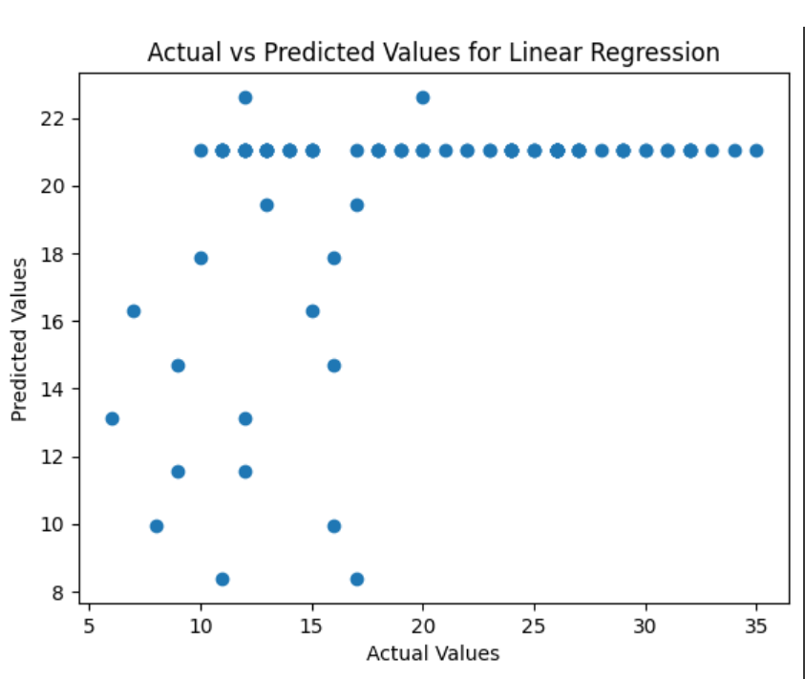
ACTUAL VS PREDICTED VALUE

Slide 14
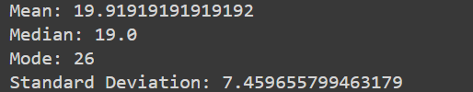
STANDARD DEVIATION, MEAN, MEDIAN, MODE

Slide 15
CONCLUSION
The code presents a comprehensive exploration of traffic data using visualization techniques and linear regression modeling. The visualizations highlight significant insights into the traffic patterns and vehicle counts over time, allowing us to observe trends and variations. The scatter plots and bar graphs visualize vehicle counts, showcasing temporal trends and providing a comparative analysis among different junctions. Additionally, descriptive statistics such as mean, median, mode, and standard deviation offer a basic yet informative overview of the central tendency and variability within the vehicle count data.

Slide 16


